Slide 1
Period 3 Review (1754 – 1800) in 10 Minutes!
Everything you need to know about Period 3 To Succeed in APUSH

Slide 2
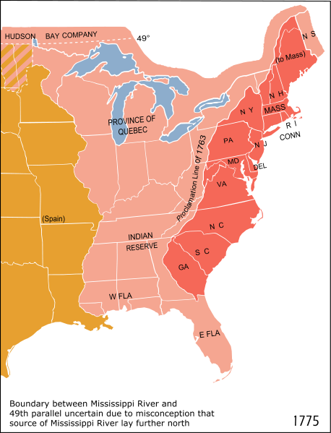

1754 - 1763
French and Indian (7 Years War) was caused by English encroachment onto French lands
Most natives (except Iroquois – split) sided with the French
Great Britain wins the war, France is removed from North America
Conflicts emerge between American colonists and Natives as colonists seek to expand
Pontiac’s Rebellion ->
Proclamation Line of 1763

Slide 3

1763 - 1776
Britain is in debt from the war, ends salutary neglect, takes a more active role in colonial affairs
Stamp Act, Townshend Acts, Intolerable Acts, etc.
Colonists resist this new control:
Stamp Act Congress, Committees of Correspondence, First Continental Congress
Elites and everyday colonists were united against the British
Up until 1776, most colonists did NOT want independence, rather they longed for salutary neglect

Slide 4
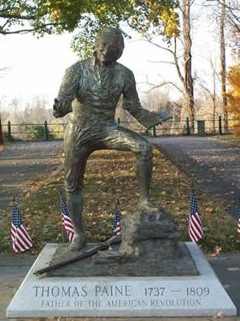
1776 - 1783
Common Sense:
Thomas Paine, urged America to break away
Helped influence the Declaration of Independence
Declaration of Independence:
Grievances against KG3, justification for breaking away
Inspired by Common Sense and other Enlightenment ideas – natural rights, consent of the governed, etc.
Why did the colonists win the war?
Familiarity with the land
Military leadership (Washington)
Strong beliefs (natural rights)
Foreign Aid – France after Saratoga

Slide 5
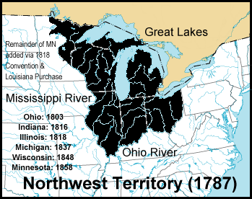
1783 – 1800
Fear of centralized power helped create the Articles of Confederation
Weak central government, could not tax, no executive branch, most power left to states
Trade issues emerged between states
Northwest Land Ordinance (1787):
Provided a process for admitting new states
Once a territory reached 60,000 people, it could apply for statehood
Banned slavery in NW Territory (MI, OH, IN, IL, WI)
Tensions emerged in different areas of the country (west v. east)
Paxton Boys - PA
Shays’ Rebellion - MA

Slide 6
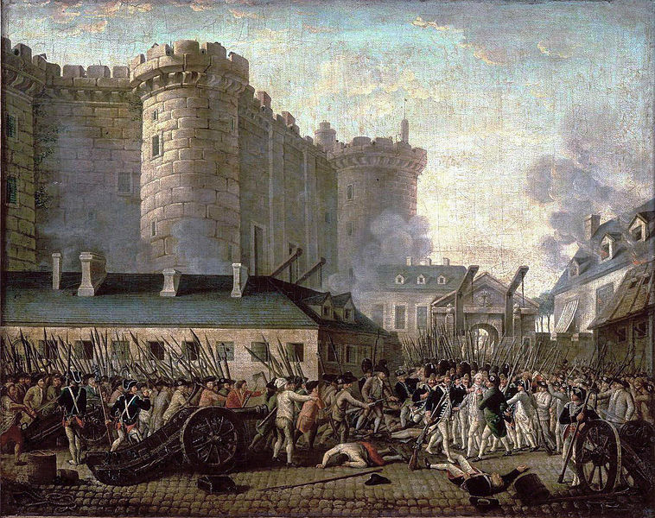
1783 – 1800 (Cont.)
Impact of the D. of I. and American Revolution?
Revolutions in France, Haiti, and Latin America
Although some called for greater equality (Abigail Adams, PA Emancipation Law), framers of the Constitution postponed the issue of slavery
Constitution:
Built on Compromises: Great, 3/5, Slave Trade
Ratified after Federalists promised Antifederalists a Bill of Rights would be added

Slide 7
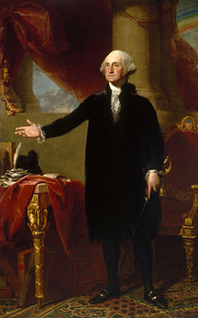
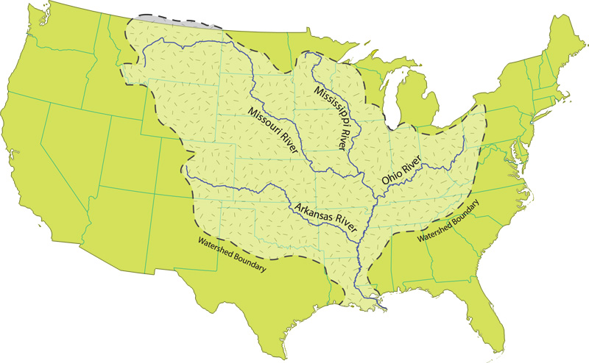
1783 – 1800 (Cont.)
Beware of foreign alliances and political parties
Challenges to the new government:
Navigation on the Mississippi River (Spain)
Pinckney’s Treaty
Relations with Natives (not defined in the Constitution), land issues as Natives ceded more and more land
Washington’s Farewell Address:
Warned of: entangled foreign alliances and political parties
Parties emerged anyway: Federalists (Hamilton) and Republicans (Jefferson)
Debates over power of government:
State vs. National – VA and KY Resolutions. Can states nullify a federal law? (NO! Constitution is “Supreme Law of the Land”)
Debate would continue until the Civil War

Slide 8
1783 – 1800 (Cont.)
So Important it gets its own slide
Republican Motherhood:
Women gained few, if any rights, after Rev. War
Women were expected to instill Republican virtues (liberty, natural rights, etc.) in children, and be active in their families
Helped improve education for women

Slide 9
Good Luck!
Subscribe to apushreview.com
Help spread the word
Questions? Comments?
Leave in comments
Subscribe for more AP videos

